Slide 1
By
K PAVAN KUMAR
Dept. Of CSE
VFSTR University

Slide 2
COMPILER DESIGN UNIT – II Syntax Analysis

Slide 3
Contents
Role of the Parser
Context-Free Grammars
Top-Down Parsing
Recursive Descent Parsing,
Predictive Parsing;
Bottom-Up Parsing
Operative Precedence Parsing,
LR Parsers–SLR, CLR, LALR
YACC: Automatic parser generator.

Slide 4

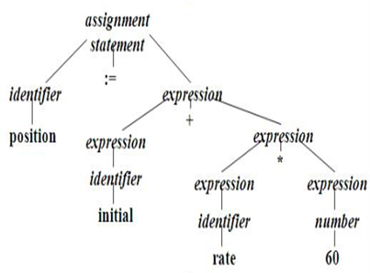
Syntax Analyser
Lexical Analysis
Syntax Analysis

Slide 5
Syntax Analyzer
Second phase of the compiler.
Performs the Hierarchical Analysis
Takes the tokens from scanner.
Checks for the syntax of the Language
Generates Parse Tree or Syntax error.
The syntax of a programming is described by a context-free grammar (CFG).

Slide 6
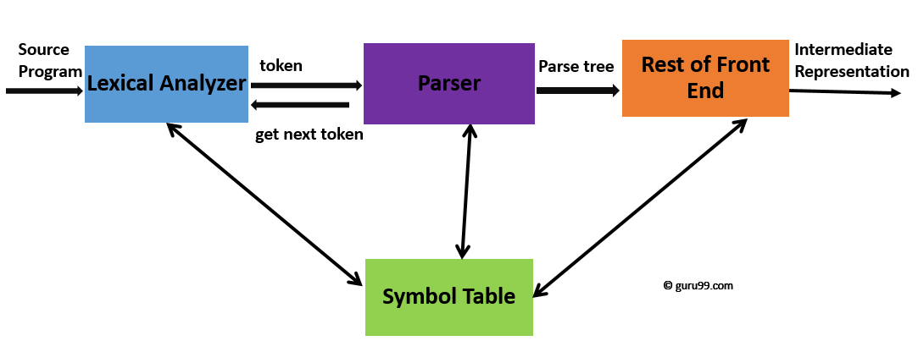
Syntax Analyzer/Parser
Input in the form of sequence of tokens and Output in the form of parse tree.

Slide 7
Role of the Parser
It obtains the string of tokens from Scanner and generates the parse tree.
It performs the action called Parsing.
It collects sufficient no of tokens by gettoken().
If not, it returns syntax errors for the language.

Slide 8

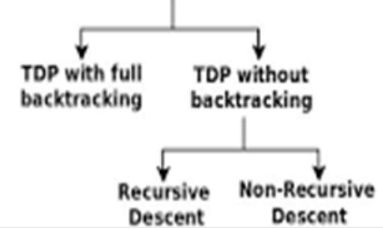
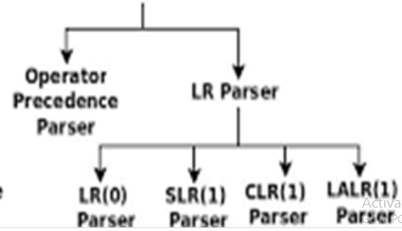
Types of Parsers:

Slide 9
Types of Parsers:
In TDP, the parser starts constructing the parse tree from the start symbol and then tries to transform the start symbol to the input.
In BUP, the parser starts with the input symbols and tries to construct the parse tree up to the start symbol.
Both are reads the characters from left to right.
At a time it reads only 1 character.

Slide 10
Summary……………
Parser
Action of Parser
Types of Parsers

Slide 11


